Slide 1
Akamai IO
Stephen Ludin
Chief Architect – Akamai Technologies

Slide 2








Community Matters!
Notes:
Community

Slide 3

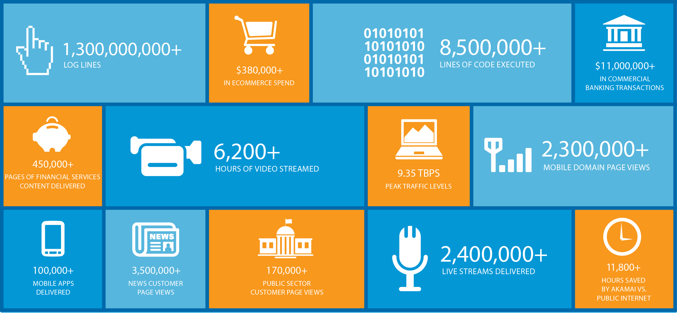

Slide 4

Akamai IO
The Akamai Internet Observatory
Akamai Technologies
FASTER FORWARDTM
©2012 Akamai

Slide 5
Akamai IO
A view into the two trillion daily requests Akamai sees every day
Akamai Technologies
FASTER FORWARDTM
©2012 Akamai

Slide 6
Akamai IO
That’s insight into 20-30% of the world’s HTTP traffic
Akamai Technologies
FASTER FORWARDTM
©2012 Akamai

Slide 7
What Data will be Available?
To Start: Browser Statistics
  Broken up by Cellular vs. Non-Cellular networks
The Plan
  Breakdowns by object types
  Page element statistics
  Trends
  APIs
  You Tell Us
Akamai Technologies
FASTER FORWARDTM
©2012 Akamai
Notes:
What Data will be available
"As our starting point, Akamai IO will focus on browser market share data. I get asked about this topic so often, that it's possible I can justify the cost of Akamai IO solely on the amount of time it'll save me in not needing to answer it anymore…"
"We'll be sharing daily summaries of browser market share, offering some focused views on Mobile Browser market share and browser version market share"
WURFL Shout-out (they're allowing our use of it for free…)
"To identify devices, we used the awesome WURFL repository. WURFL is an extremely comprehensive database, and was instrumental to us in understanding user-agent strings. It's great that the guys at Scientia Mobile are supporting these types of community tools by sharing WURFL. I'm not sure if they have a booth here or not, but if they do, be sure to stop by and say thanks!"

Slide 8
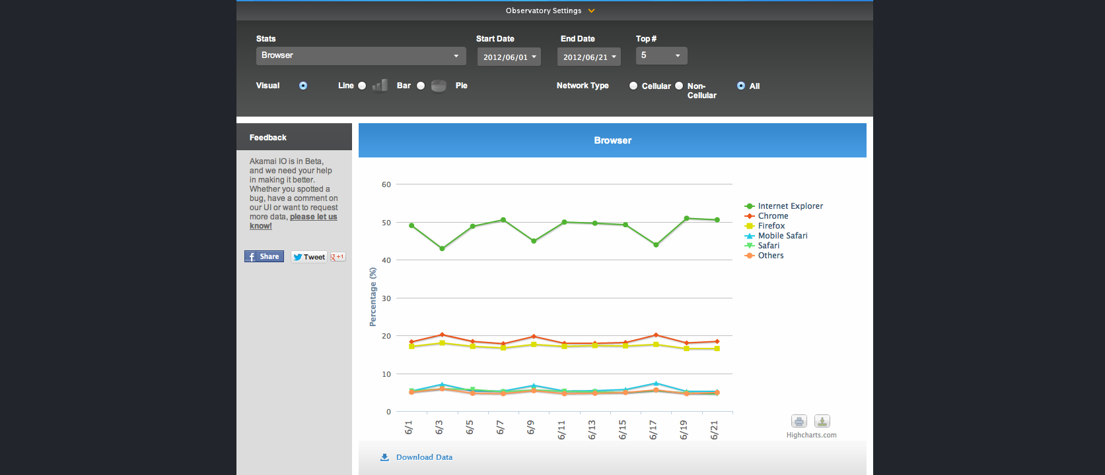

Slide 9
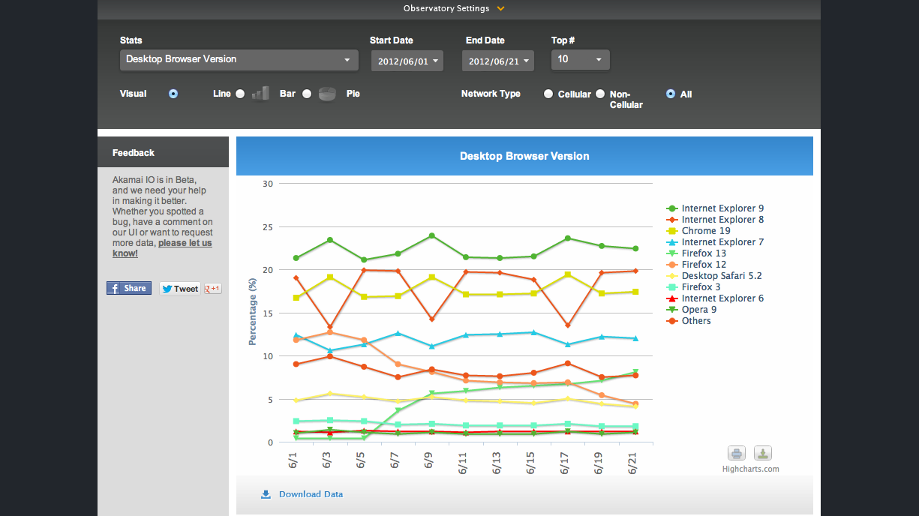

Slide 10
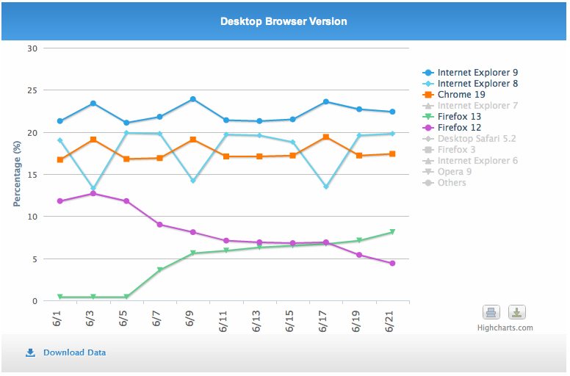

Slide 11
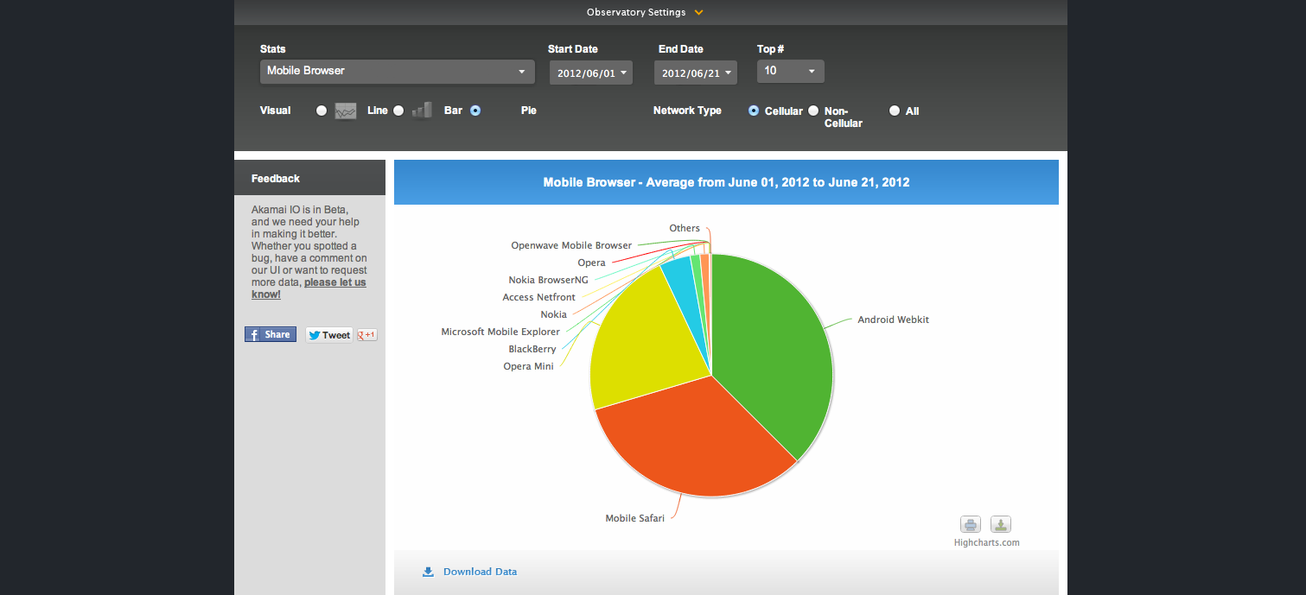

Slide 12
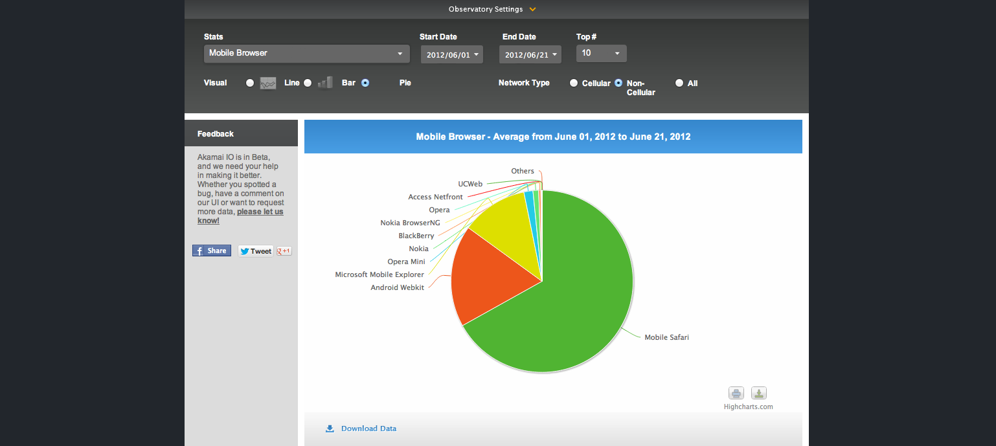

Slide 13
Akamai IO
www.akamai.io
Akamai Technologies
FASTER FORWARDTM
©2012 Akamai

Slide 14

Pardon our Dust
Akamai Technologies
FASTER FORWARDTM
©2012 Akamai
Notes:
It’s a Beta, Boys
"Like all good things, Akamai IO is starting off as Beta. "
"This applies both to the tool itself, and to the data we're sharing."
"Over the next few months we'll expand the sample size and refine our processing of it, and take off the Beta mark when we're absolutely certain there are no unintended biases in there"
"This first round of the beta uses roughly 600M requests/day, from several hundred websites. While that may sound big to some of you, that's a tiny amount for us, and we plan on growing that sample significantly"
"The other bias worth noting is that the sampled websites right now are mostly targeted at a US audience. For that reason, we're not offering a view by geo just yet – we'll add that once we expand the sample, hopefully very soon"

Slide 15
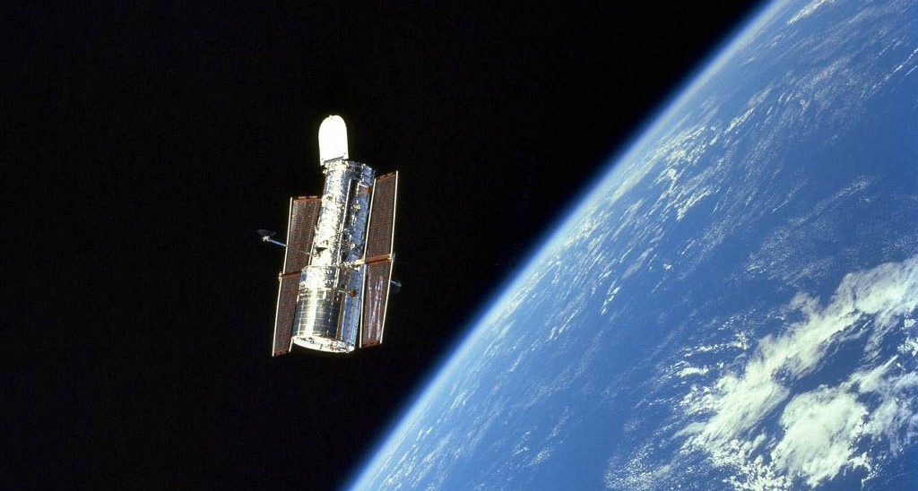
What’s Next?
Akamai Technologies
FASTER FORWARDTM
©2012 Akamai

